Slide 1
Single Point Lessons
Workstations for Surgical Mask Clip manufacture
See also ‘Manufacturing SOP’ for source content
Questions to: drewewendesign@gmail.com
Approved: Ward Hills
Date: 01 April 2020

Slide 2

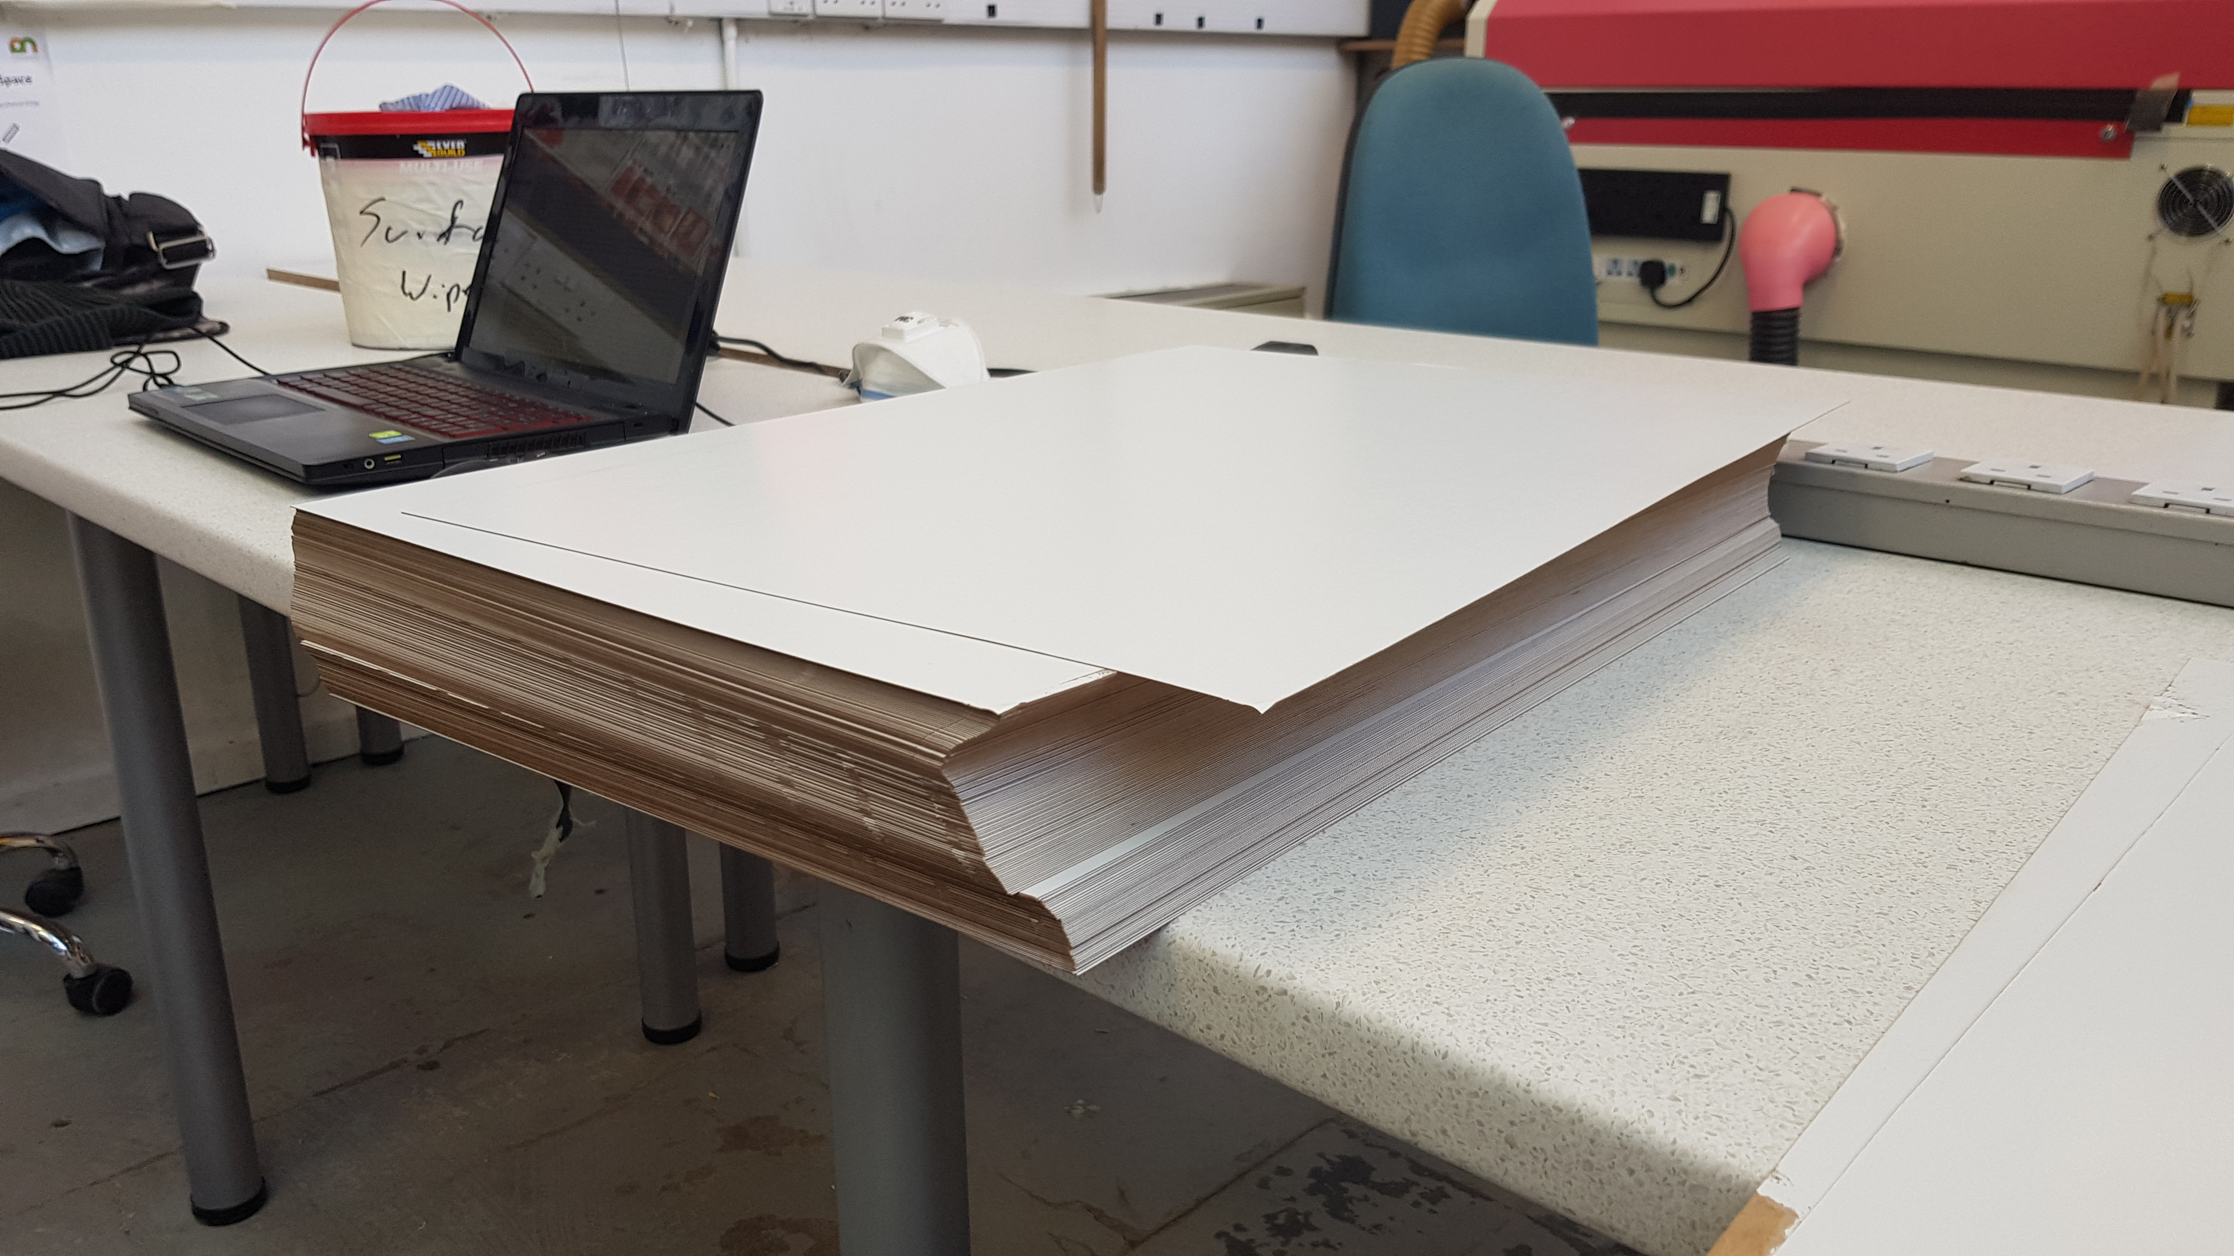
Station 1 – Goods in and Storage
No scratches or marks on the card.
Steps
Place card stock in goods in storage area and cover with clean scrap card.
Leave the covered card in quarantine for 24 hours.
Once the time has elapsed card can be moved into processing clean area.
Handling
SAFETY
QUALITY
Approved: Ward Hills
Date: 01 April 2020

Slide 3
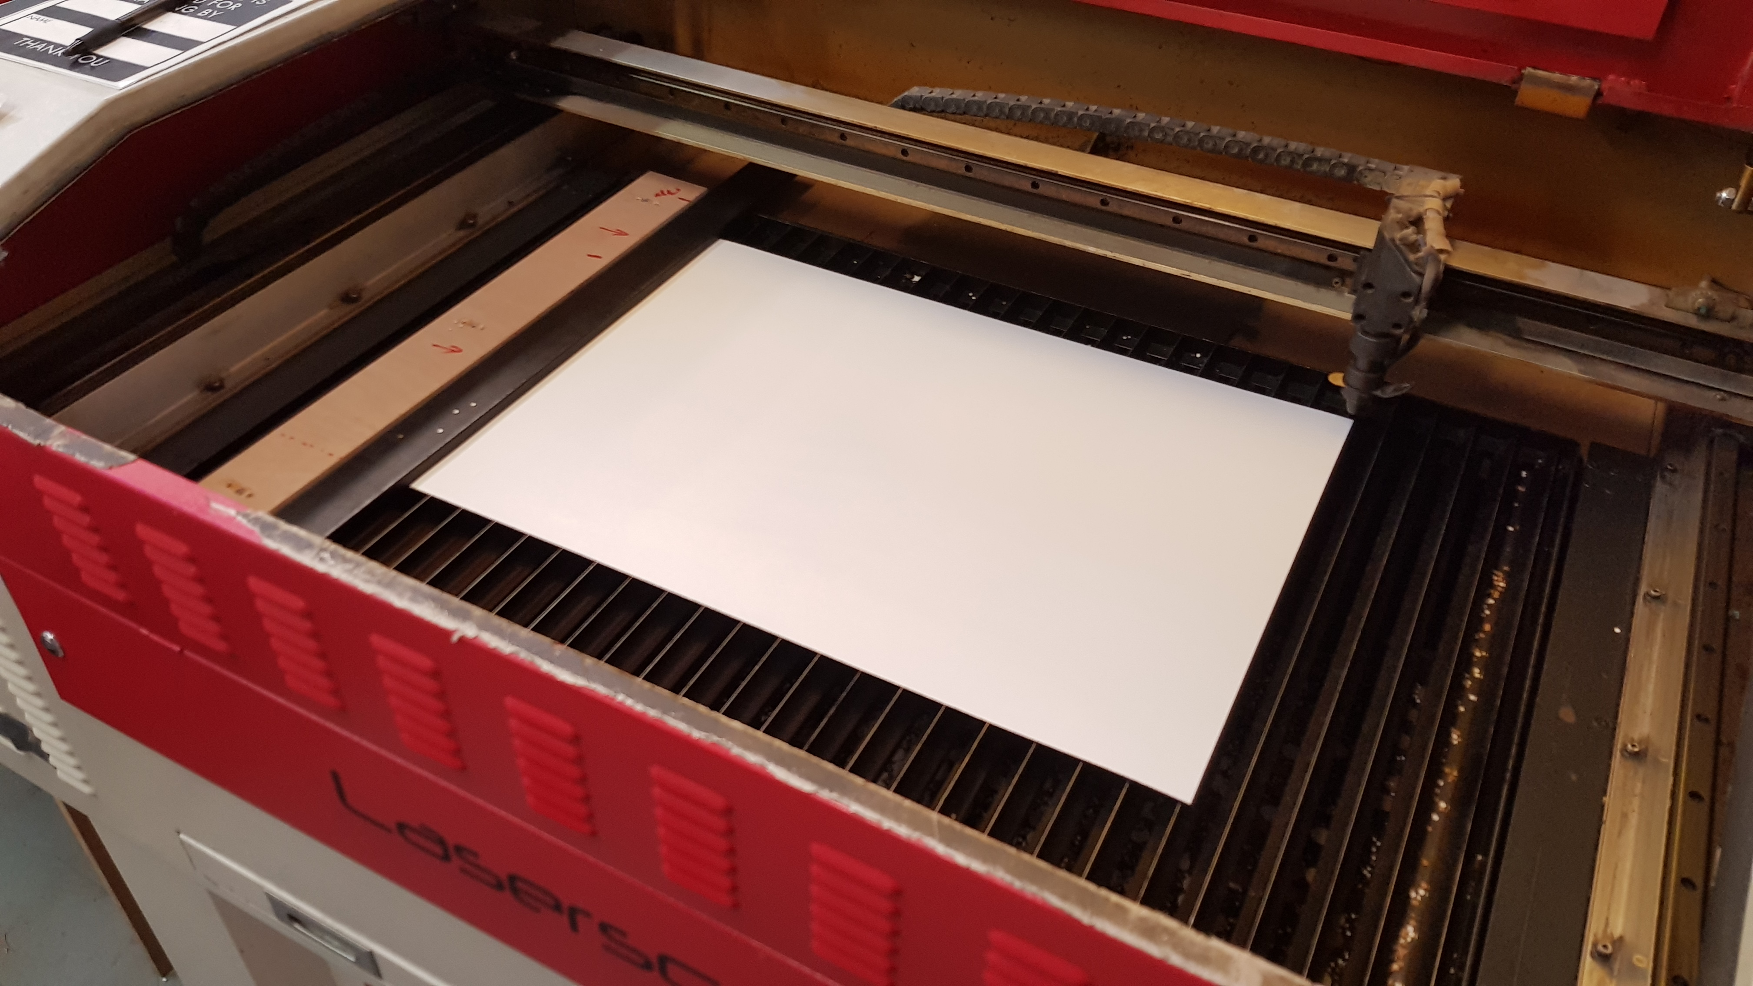
Station 2 – Laser Cutting
Handling
Laser
INDUCTION TRAINED
No scratches or marks on the card.
Minimal burn marks.
Steps
Remove 2 sheet of card from processing clean area.
Place card sheets together (brown to brown).
Insert combined sheets into laser cutter and align to jig.
Close lid and run cut cycle.
Watch sequence and cutting process.
Once complete, remove all parts including skeletal waste and place in post processing area.
If any clips fall though the slats remove and place in a separate pile.
Repeat steps 1-7.
SAFETY
QUALITY
Approved: Ward Hills
Date: 01 April 2020

Slide 4
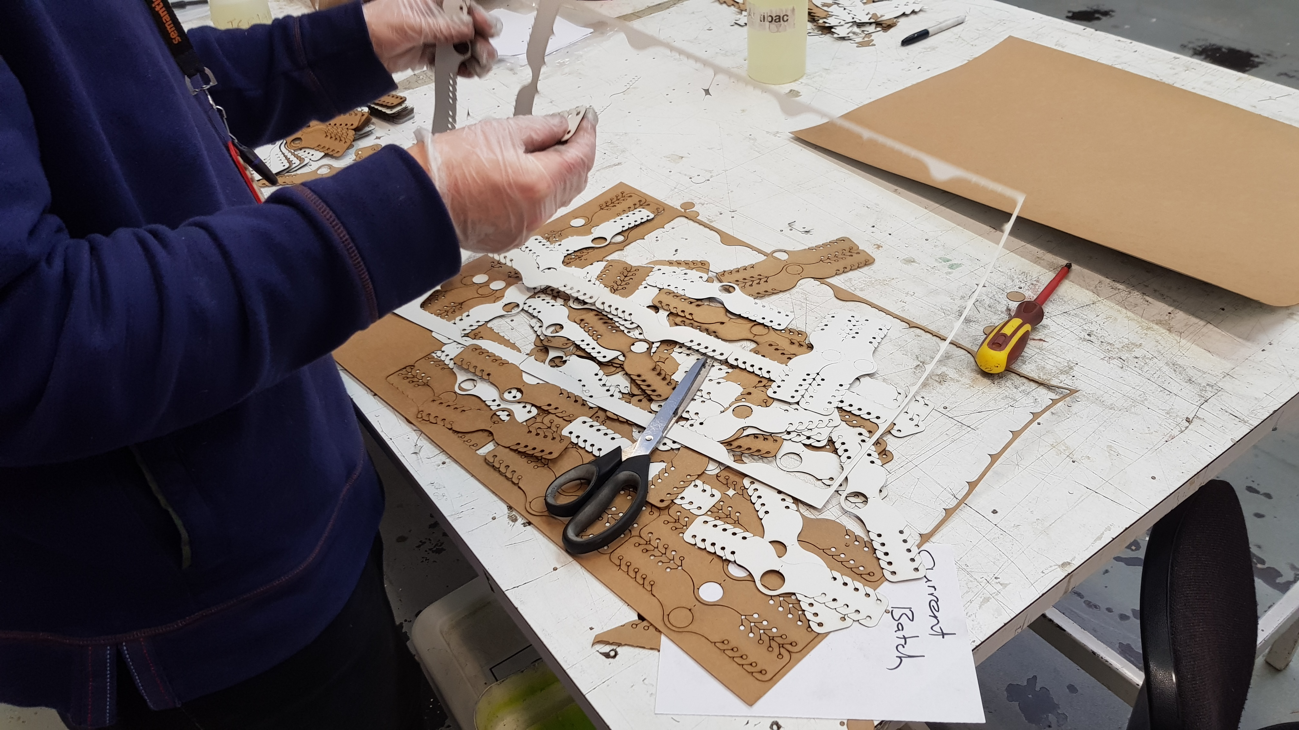
Station 3 – Post Processing – General
No scratches or marks on the card.
Minimal burn marks and staining.
Steps
Separate all clips from skeletal waste.
If still attached use scissors or scalpel to cut free (use cutting board for this).
If clips require weeding, see: 3.1 - Post Processing – Weeding.
Check clips for burn marks and staining during these steps.
Note down number of sheets past to QC for Bagging.
Handling
Sharp blade
SAFETY
QUALITY
Approved: Ward Hills
Date: 01 April 2020

Slide 5
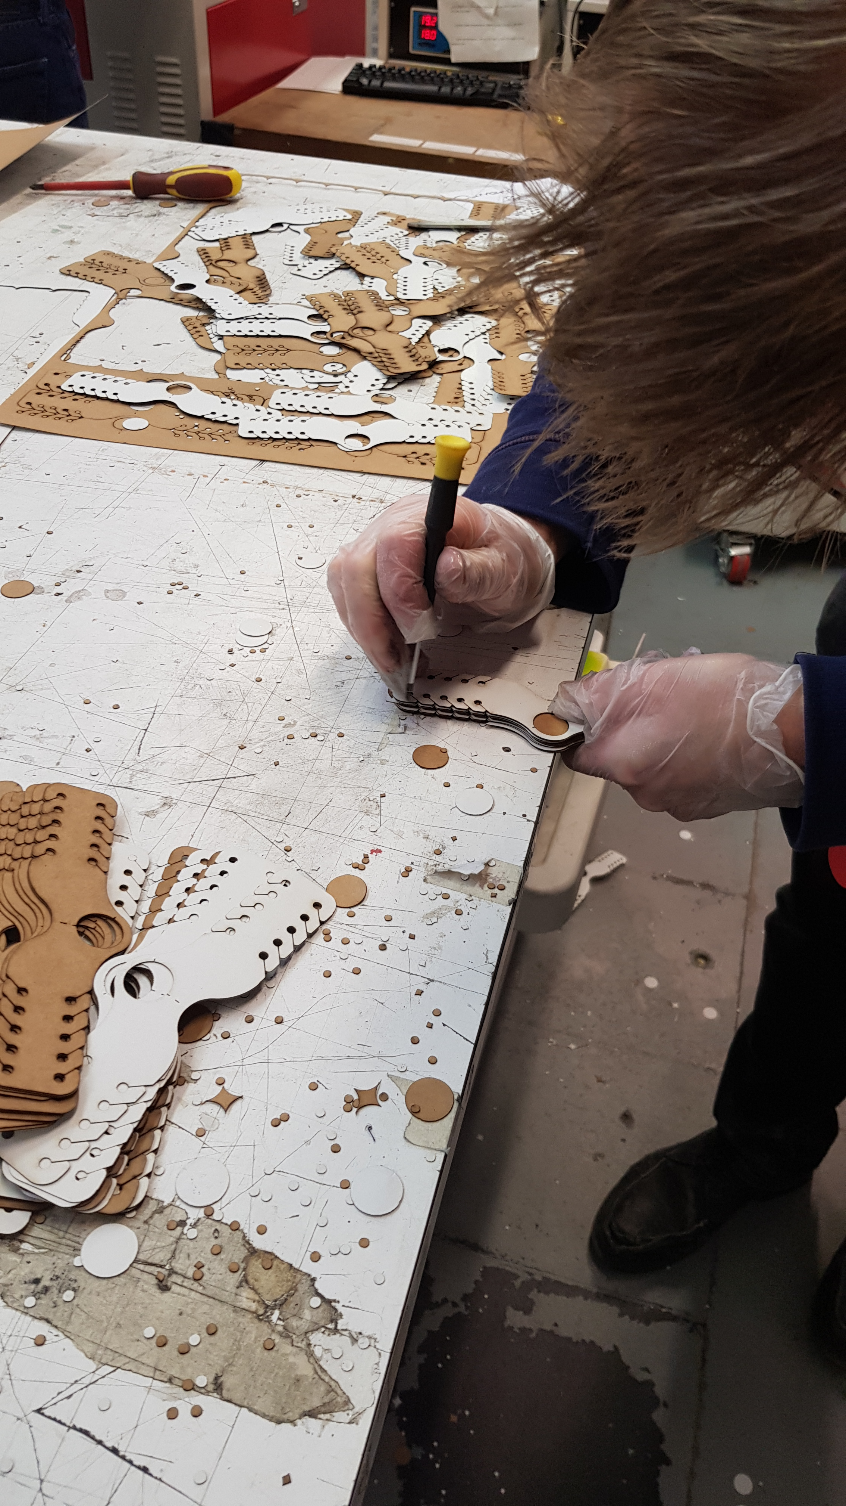
Station 3.1 – Post Processing – Weeding
Handling
Stabbing holes
Steps
Stack Clips in line - approx. 25mm high.
Use T7 screwdriver (or approximate alternative) and poke each hole until it begins to jam.
Riffle stack to release the excess punched holes.
Repeat process until all holes are clear.
Rotate stack 180° and repeat until all holes in stack are clear.
All holes to be clear.
SAFETY
QUALITY
Approved: Ward Hills
Date: 01 April 2020

Slide 6
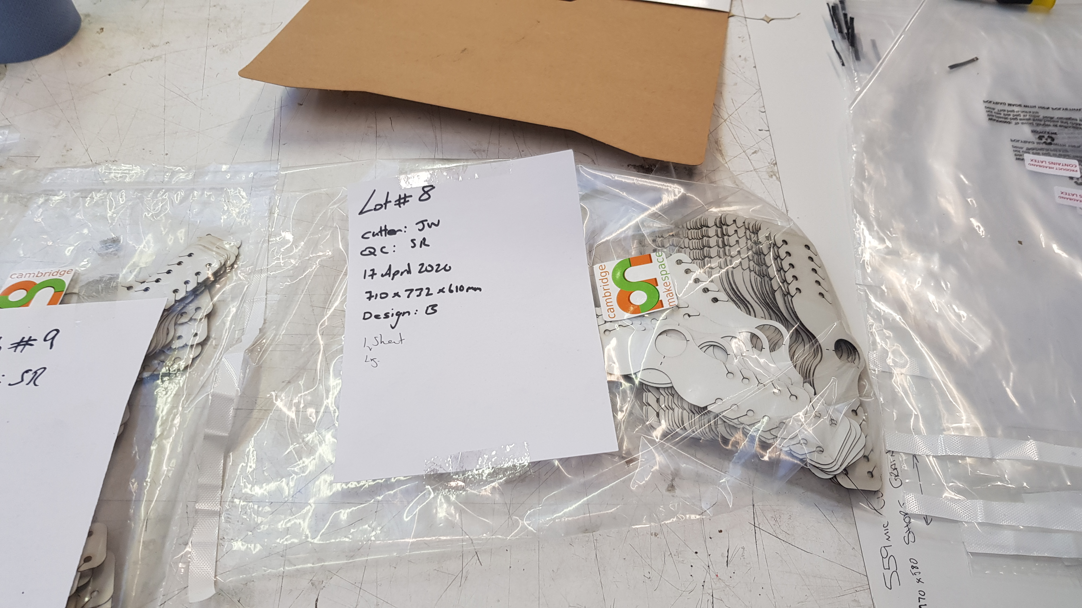
Station 4 – QC
No scratches or marks on the card.
Minimal burn marks and staining.
All holes to be clear.
Steps
Ensure all clips are separated.
Perform checks, as per the checklist at the station
Place all passed clips into clear bag, any rejects to be discarded.
Cover “Contains Latex” with MS logo sticker.
Fill bag with as many clips as possible ensure that number of sheets are used to fill bag is recorded.
Fill out Job Card and attach to bag.
Seal bag and place in designated area.
Handling
SAFETY
QUALITY
Approved: Ward Hills
Date: 01 April 2020

